Slide 1
Amazon Product Reviews
By: Akshay Shinde, Lakshmi Gade, Bishoy Soliman Hanna, Dylan Hoffman, Vagmi Bhagavathula
Notes:
Vagmi

Slide 2

Agenda
Amazon Description
BI Process and Proposed Solution
Dataset Description
Key Performance Indicators
Dashboard(s)
Recommendations
Limitations
Conclusion
Notes:
Vagmi

Slide 3
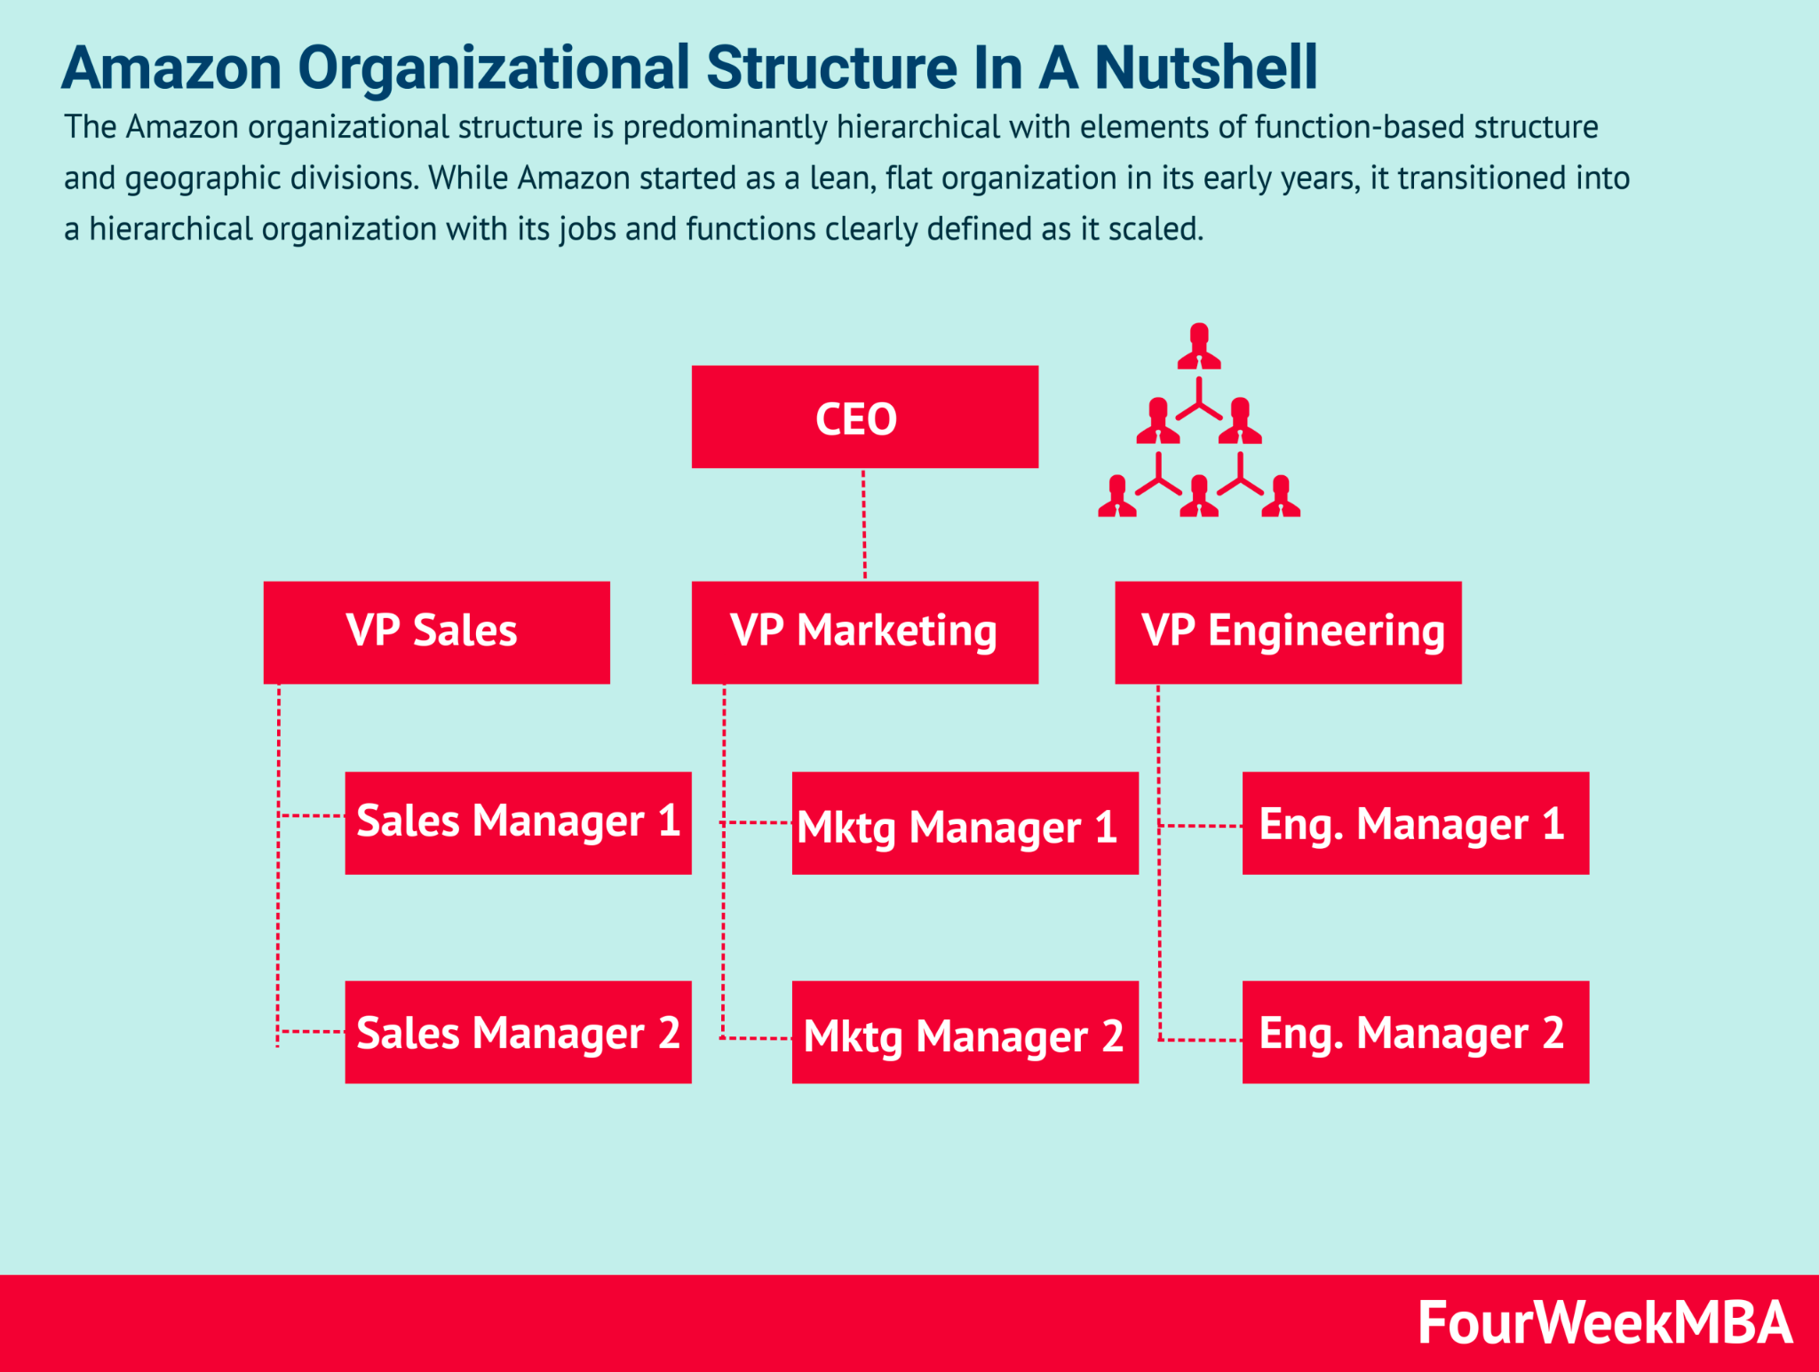
Amazon Description
Multinational company located in Seattle, WA
Specialize in E-commerce but well known for cloud-computing, artificial intelligence, and streaming services
Over 40 departments with 100 internal teams in each
Market Cap: ~$1.5 TRILLION
Notes:
Vagmi

Slide 4


Amazon Business Intelligence Process
Amazon stores business reports in CSV file formats
Amazon Web Services and Amazon Redshift two proprietary products
specialize in data warehousing and cloud-computing
Able to generate dashboards and store data at a high-processing rate
Have their own BI team, consisting of several feature engineers and dashboard developers
Notes:
Vagmi

Slide 5
Proposed BI Architecture Solution for Amazon
Expected Value of BI
Optimized Inventory Management
Customer Experience Personalization
Supply Chain Efficiency
Market Trend Analysis
Operational Databases
facilitating immediate order processing and customer service interactions.
External Data Sources:
e.g. market research data, social media trends, and economic indicators
ETL Processes: (Extract, Transform, Load) processes
AWS Glue automates the preparation and loads data into the warehouse.
Data Analytics and Reporting Tools
AWS QuickSight and Tableau
Advanced Analytics: leverage machine learning and predictive analytics to forecast trends and automate decision-making processes.
AWS SageMaker
Notes:
Vagmi

Slide 6
Research Areas and Datasets
Amazon Product Sales Dataset
96724 rows 9 columns
Main Category, Subcategory, Image, Link, Ratings, number of ratings, actual price
Amazon Sales Dataset
1466 rows by 23 columns
Main Category, Subcategory, ID, Name, discount price, actual price, discount percentage, user id, review ID, review Title, Review, Links to product
Notes:
Dylan
Linked to case study on Walmart

Slide 7

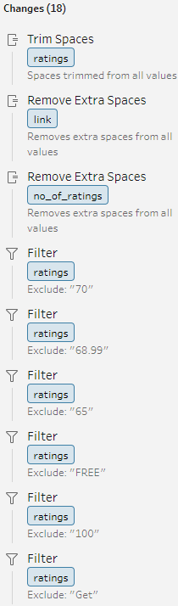
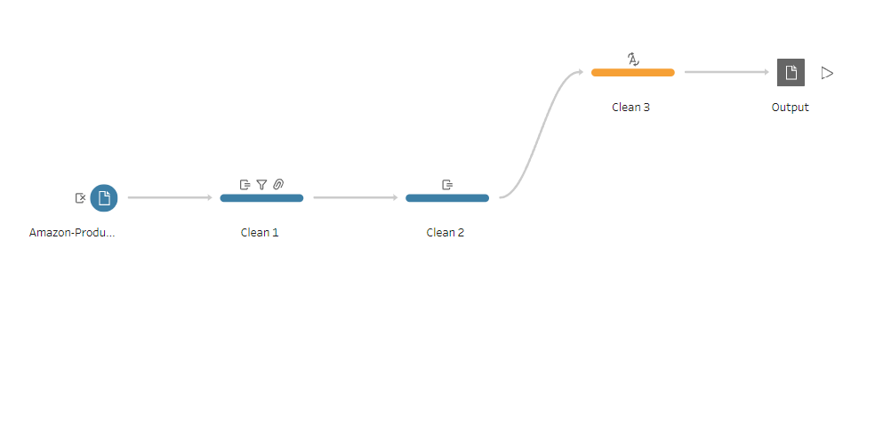
Data Cleansing
Initial Assessment
Deduplication
Data Type Standardization
Handling Missing Values
Filtering Irrelevant Data
Error Correction
Data Aggregation
Column Renaming and Reordering
Notes:
Dylan
96000+ Rows Amazon Products
1400+ Rows Amazon Sales + Reviews

Slide 8
Key Performance Indicators
Notes:
Dylan
Total Revenue, Product Performance, Customer Satisfaction and Engagement, Inventory Stock Status, Customer satisfaction and discount correlation index, Total Sales by discount percentage,

Slide 9
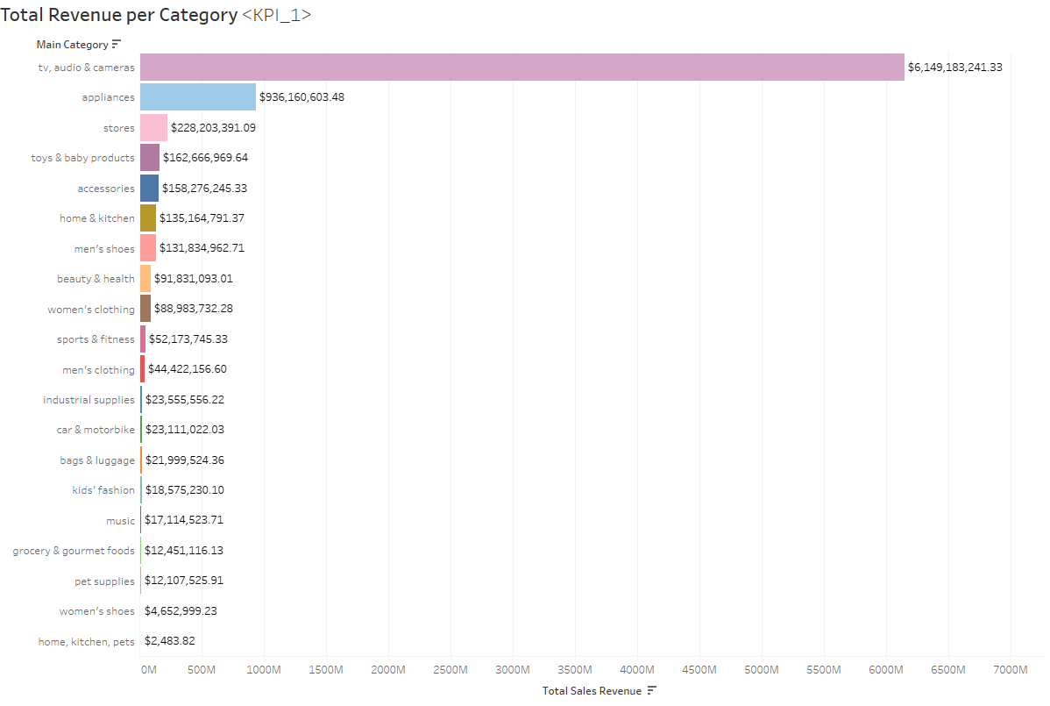
Total Revenue by Category
The goal is to measure the total sales revenue generated by each product category, providing insight into which categories are the top performers in terms of sales.
Business Impact:
Provided strategic insights for resource allocation, marketing focus, and product development priorities based on revenue trends.
Notes:
Dylan

Slide 10
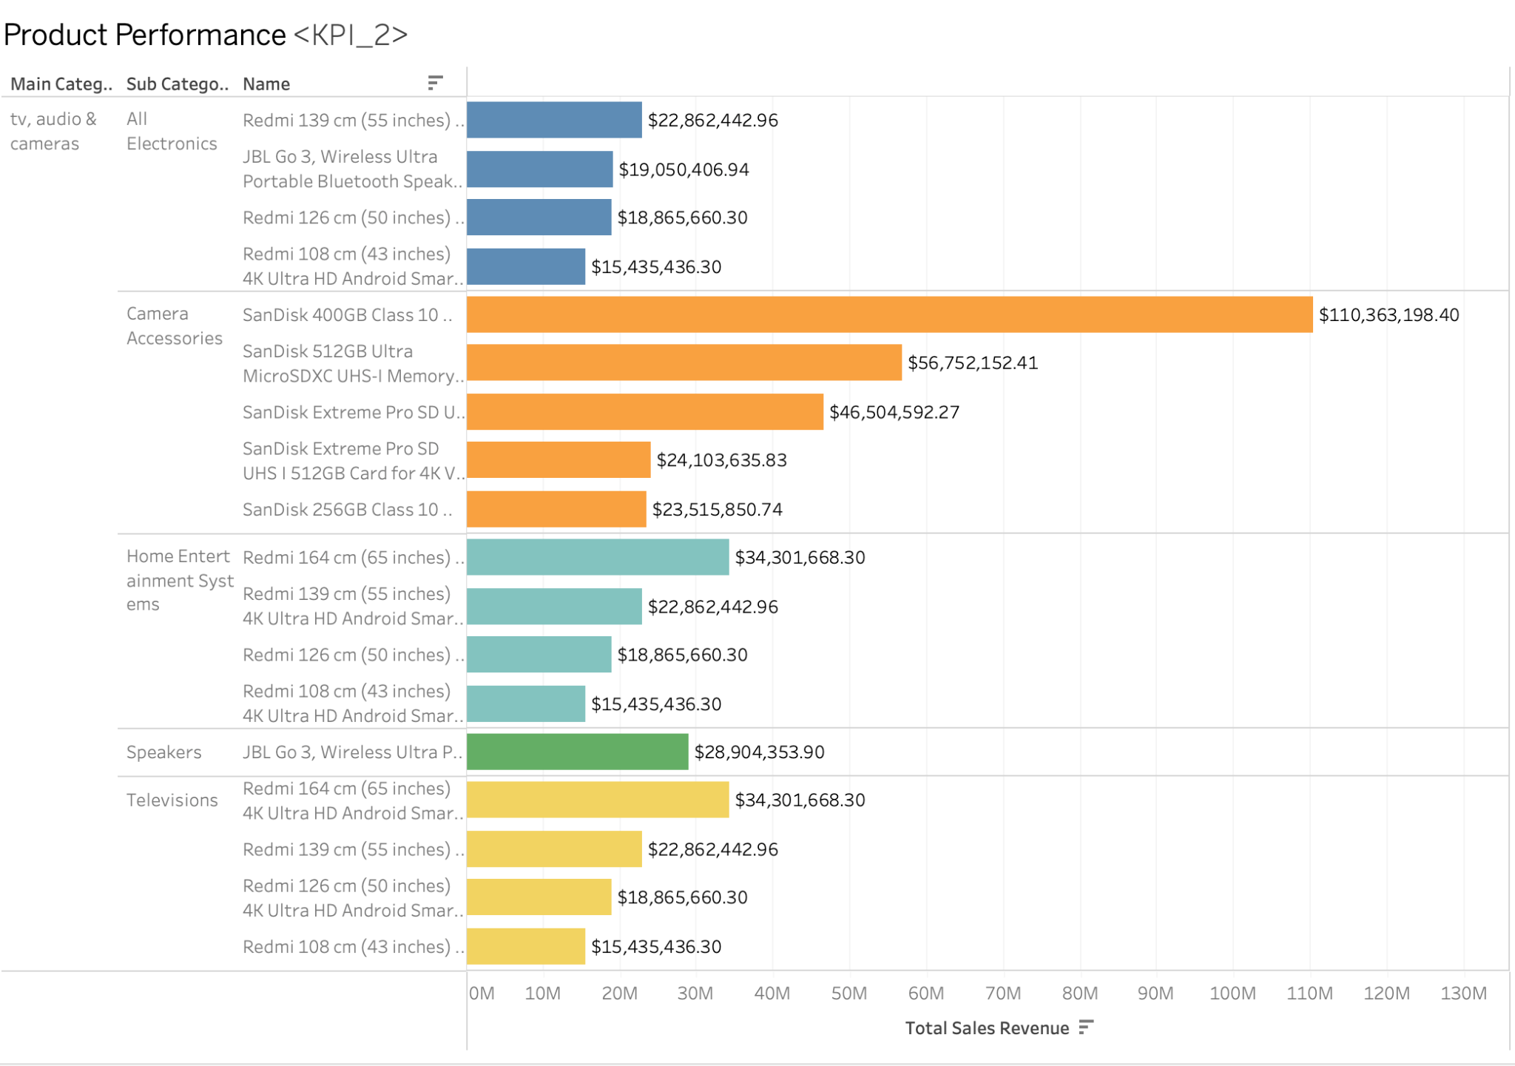
Product Performance
Evaluates individual product success based on sales volume, customer ratings, and return rates to gauge overall market performance.
Strategic Outcomes:
Informs product strategy, including inventory management, pricing adjustments, and targeted marketing initiatives.
Notes:
Ananya

Slide 11
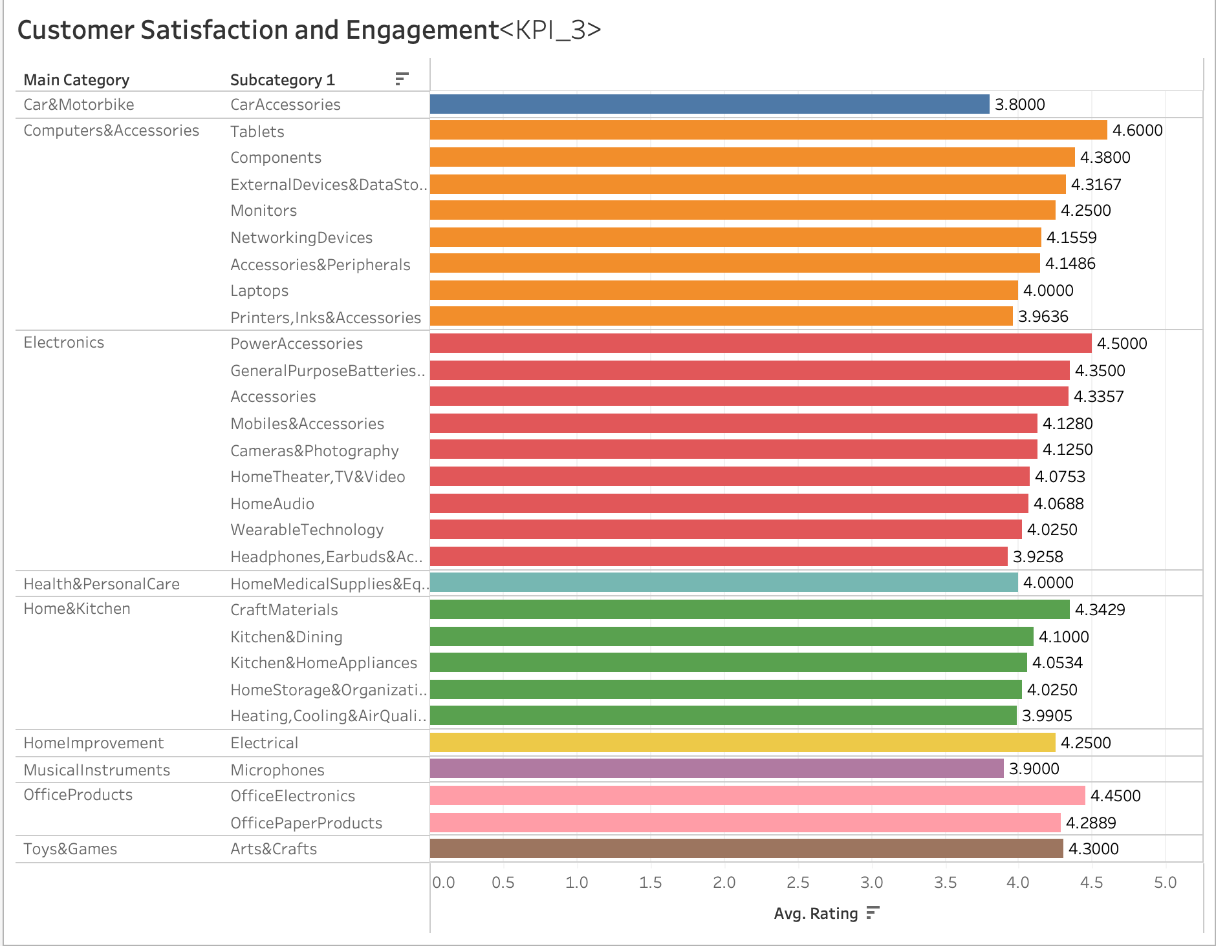
Customer Satisfaction and Engagement
Measures the level of customer satisfaction and engagement through ratings, reviews, and repeat purchase data.
Strategic Influence:
Directs customer service improvements, product development, and informs CRM strategies to enhance overall customer experience.
Notes:
Ananya

Slide 12
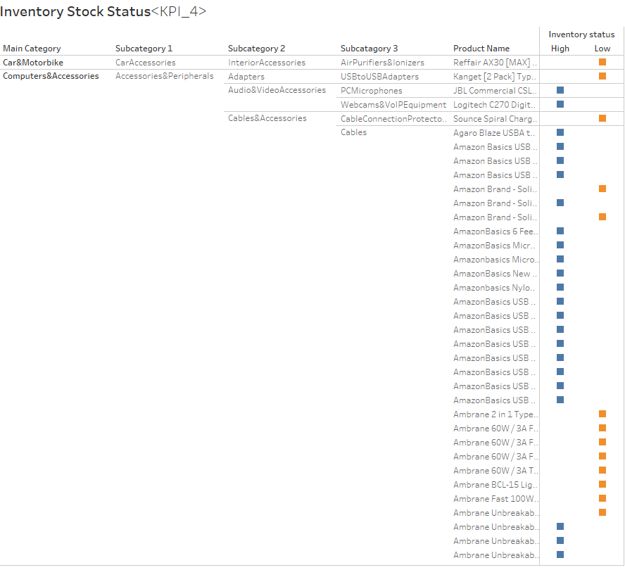
Inventory Stock Status
Assesses inventory health by tracking stock levels, turnover rates, and aging to optimize inventory management.
Impact on Supply Chain:
Provides actionable insights for supply chain optimization, aligning inventory levels with forecasted consumer demand.
Notes:
Ananya

Slide 13
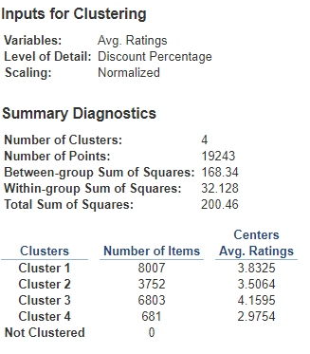
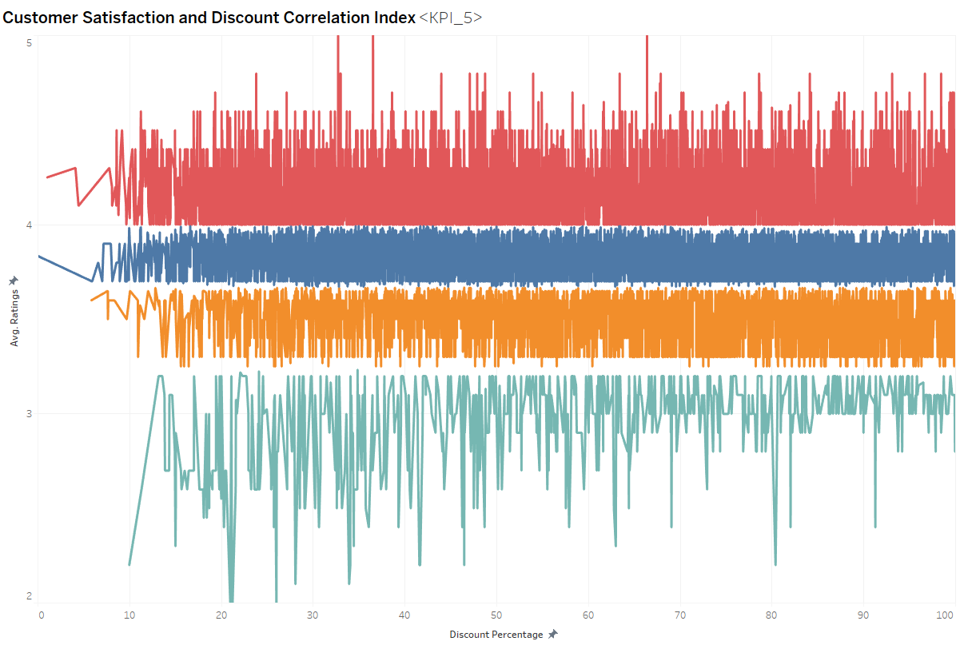
Customer Satisfaction and Discount Correlation Index
It is centered on revealing the relationship between discount percentages offered on products and the resulting average customer ratings, which serve as a proxy for customer satisfaction.
Strategic implications:
Helps tailored discount strategies to enhance customer satisfaction and sales.
Pinpoints where product improvements are needed for better customer approval.
Notes:
Bishoy
Key Findings:
Cluster 1: represents products with high customer ratings and moderate discounts.
Cluster 2: includes products with average satisfaction levels and lower discounts.
Cluster 3: includes products with the highest customer ratings regardless of discount levels. Indicates a preference for quality.
Cluster 4: contains products with the lowest ratings offered at various discounts. Highlights potential areas for product improvement.

Slide 14
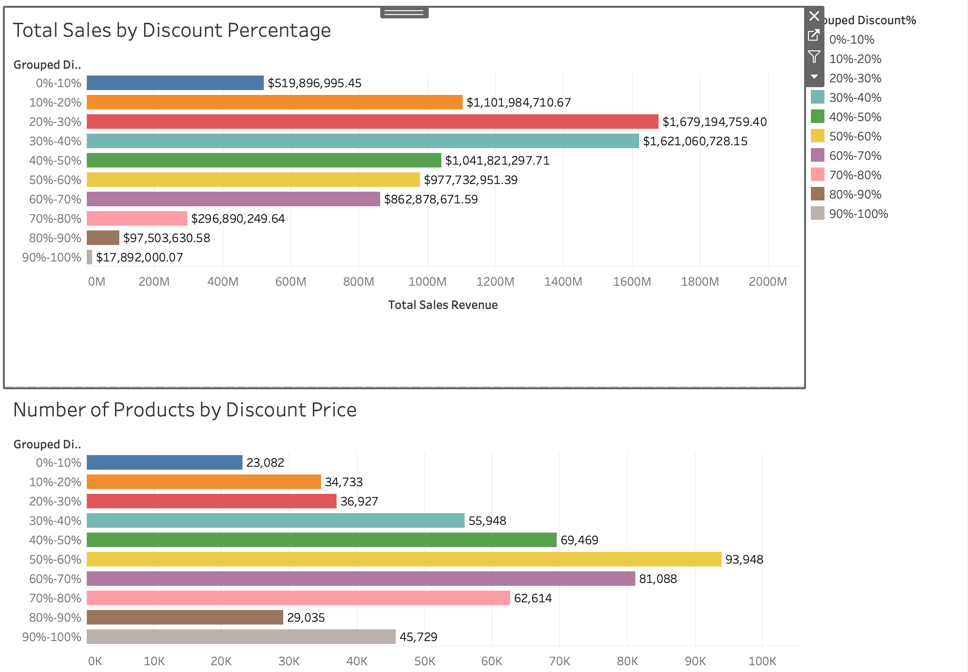
Total Sales by Discount Percentage
Presents the relationship between product performance by discount percentage offered for that product.
Strategic Implications
Provide insights to marketing team for which deals to promote to boost sales
Notes:
Akshay

Slide 15
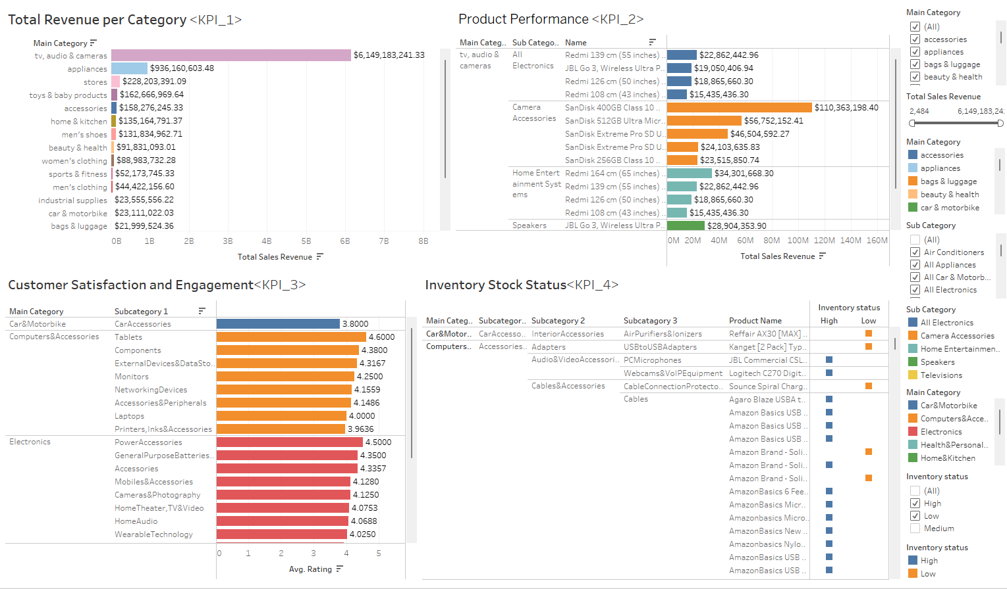
Dashboard 1
Notes:
Akshay

Slide 16
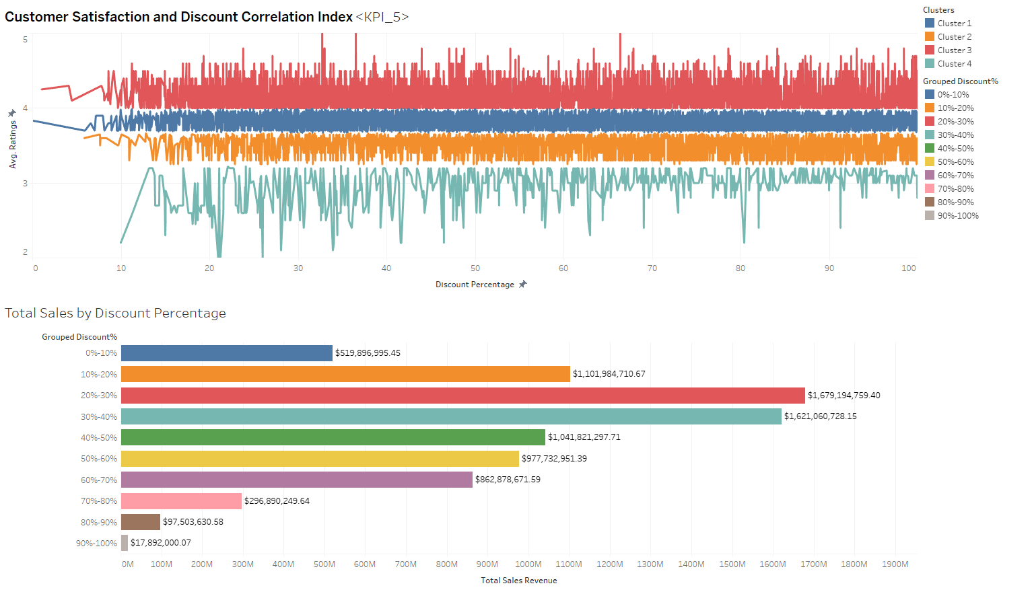
Dashboard 2
Notes:
Akshay

Slide 17
Recommendations
Advanced Data Integration for example Combine additional data sources like customer demographics or economic indicators.
Employ predictive modeling to forecast future trends in sales, customer satisfaction, and inventory needs.
Develop new KPIs that focus on emerging business areas or market trends, such as online engagement metrics or sustainability measures.
Utilize machine learning algorithms to personalize marketing and sales efforts based on individual customer behaviours.
Notes:
Bishoy

Slide 18
Limitations
Initially proposed three datasets, but last dataset was redundant
The two for this research study already encompassed most of the KPIs
Unable to join the datasets into one
No common column between the both
Had to separate a product category into 7 different categories to fit consistently into the dashboard
Notes:
Vagmi

Slide 19
Summary
Amazon Overview: A multinational company leading in e-commerce, cloud computing, and AI.
Data Utilized: Analysis based on two Amazon datasets.
KPI Analysis: Emphasis on total revenue by category, product performance, customer satisfaction, and sales trends.
Recommendations: Focus on advanced data integration, predictive modeling, new KPI development, and leveraging machine learning for marketing.
Data Limitations: Addressing challenges in dataset integration and representation limitations.
Notes:
Bishoy

Slide 20
Questions?

